Slide 1
ECE 333 Green Energy Systems
Lecture 12: Economics
Dr. Karl Reinhard
Dept. of Electrical and Computer Engineering
University of Illinois at Urbana-Champaign
reinhrd2@illinois.edu

Slide 2
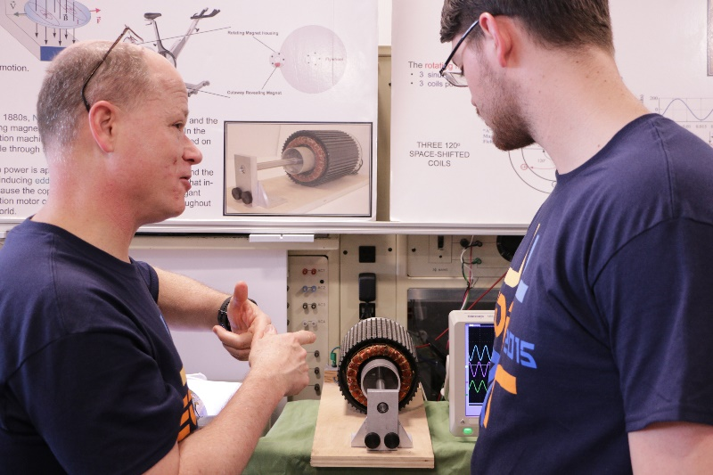
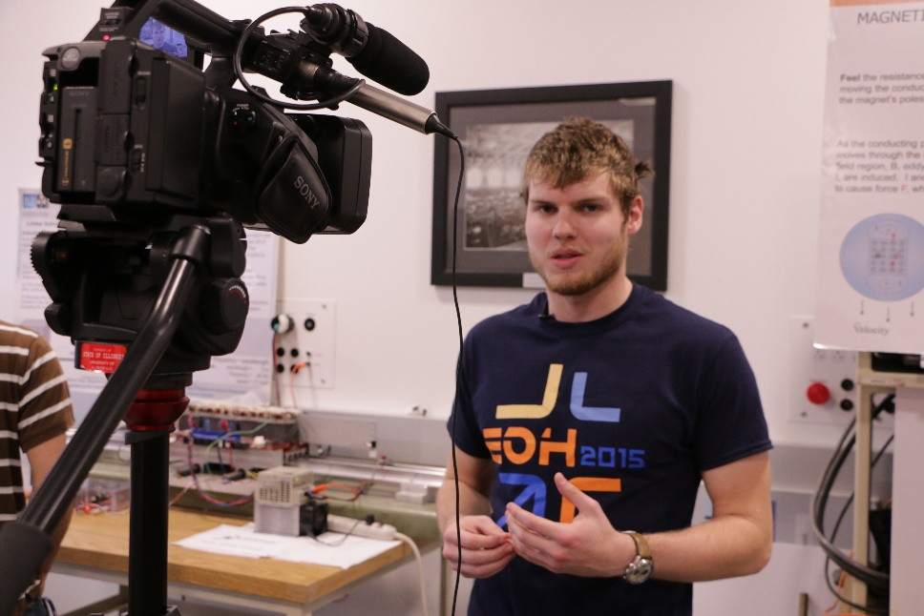
Announcements
HW 6 is posted.
Quiz 6 on Thursday
Reading Chapter 5, 6, & App A
Need EOH Volunteers – Xtra Credit Opportunity

Slide 3
Energy Economic Concepts
General economic concepts that are useful in evaluating renewable energy projects
Useful in general, but quite appropriate for distributed PV system analysis
Covered partially in Section 6.4 (PV) , 7.9 (Wind), and Appendix A
Concepts will be revisited through course end

Slide 4
Energy Economic Concepts
Energy resource project alternative evaluation requires meaningful co$t quantification & comparison
fixed costs
variable costs
Engineering Economics techniques provide consistent bases for analyzing options
Two (or more) projects
Costs with and without a given project
Understanding long term costs – many co$t centers

Slide 5
Time Value of Money
Basic notion: $1 today does not have same value as a $1 one year from today
Would you rather have $10 now or $50 in five years?
What would a $50,000 purchase you’ll make in 10 years be worth today?
We will use the convention that payments occur at the end of period (e.o.p.)

Slide 6
Time Value of Money – Principle and Interest
Principle (P) – the initial $ amount
Interest (i) – money’s productivity over time, today’s $ vs. future $
Simple interest –interest is only paid on the principle amount
Compounded interest – (what we consider)
interest is paid on (interest $ + principle $) at specified intervals
$’s grow faster w/ compounded interest, especially as
i ↑ ,
compounding frequency ↓,
payment # ↑
P = principal
EXAMPLE!
i = interest rate

Slide 7
Positive Interest Rate (i > 0)
‘+’i → $1 in 10 years has less value than $1 today
The assumption is that over 10 years, you can use the $1 to make more money
Worst case – put your $1 under you mattress
A bit better – put your $1 in the bank and earn interest (<< 1%)
Better yet – invest in a project with higher potential return
Hence, i > 0 → Future value > Present value ….. (F > P)

Slide 8
Compound Interest
e.o.p. | amount owed | interest for next period | amount owed for next period
0 | P | Pi | P + Pi = P(1+i )
1 | P(1+i ) | P(1+i ) i | P(1+i ) + P(1+i ) i = P(1+i ) ²
2 | P(1+i ) ² | P(1+i ) ² i | P(1+i ) ² + P(1+i ) ² i = P(1+i ) ³
3 | P(1+i ) ³ | P(1+i ) ³ i | P(1+i ) ³ + P(1+i ) ³ i = P(1+i ) ⁴
n-1 | P(1+i ) ^{n-1} | P(1+i ) ^{n-1} i | P(1+i ) ^{n-1} + P(1+i ) ^{n-1} i = P(1+i ) ^{n}
n | P(1+i ) ^{n}
The value in the last column for the e.o.p. (k-1) provides the value in the first column for the e.o.p. k (e.o.p. – end of period)

Slide 9
Terminology
(1 + i ) ^{n} is the single payment compound amount factor
We define
and
is the single payment Present Value Factor (PVF)
F is the future worth;
P is the present value (or present worth) @ interest rate i of future sum F
or

Slide 10
Cash Flows
A cash flow is a transfer of an amount A _{t} from one entity to another at e.o.p. time t
Each cash flow has (1) amount, (2) time, and (3) sign
Example:
Take out a loan
0
1
2
3
4
Make 4 equal repayments over 4 years

Slide 11
Cash Flows Diagrams - Overview
Convention for cash flows
+ inflow
− outflow
End of year 1
0
1
2
3
4
Present
Ex.
Ex.
Take out a loan
Revenue collected
Initial purchase
Payments made
Incoming cash flows
Outgoing cash flows

Slide 12
Discount Rate
The interest rate i is typically referred to as the discount rate d because it is used to “discount” cash flows to the present
In converting a future amount F to a present worth P, we can view the discount rate as the interest rate that can be earned from the best investment alternative
A postulated savings of $ 10,000 in a project in 5 years is worth at present
PVF

Slide 13
Discount Rate
For d = 0.1, P = $ 6,201,
while for d = 0.2, P = $ 4,019
In general the lower the d, the higher the present worth
The present worth of a set of costs under a given discount rate is called the life-cycle costs
Distinction between i and d
i is a known contractual charge for borrowing money
d is an educated guess about the best use of money

Slide 14
Equivalence
It can be difficult to tell if a project makes sense or not just from the cash flow diagram
This is because the payments are in different years, and the value of money in different years is not equivalent
But, we saw that
This means that with an interest rate of i, $ P today is equivalent to $ F at the end of year n

Slide 15
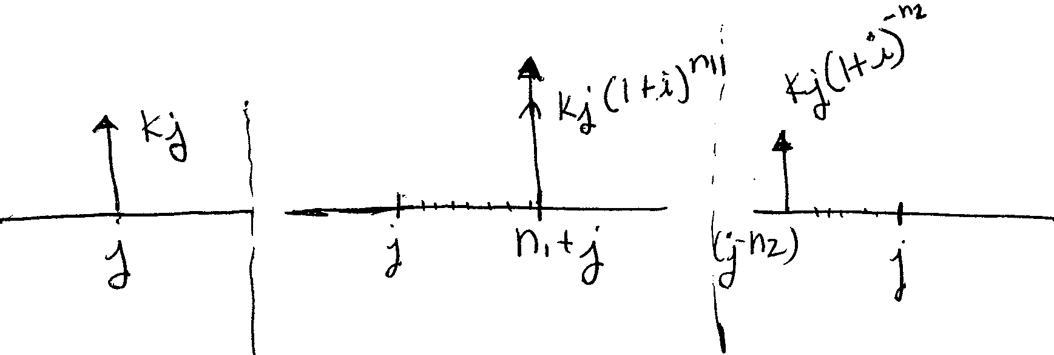
Equivalence
W/ this idea, “move” or “discount ” any amount to a
future year ( j + n₁) or….
past year ( j – n₂) using the discount rate d
Hence, the following 3 cash flow sets are equivalent:

Slide 16
Equivalence
Projects can be compared by examining the equivalence of their cash flow sets
Two cash-flow sets (i.e., project costs over time)
are equivalent cash-flow sets under a given d, if the sets discounted to any common time point are identical.
Common practice is to discount sets to the Present – Net Present Value (NPV)) – though any common time point can be chosen

Slide 17
Equivalence Example 1
Are these cash-flow sets equivalent?
8,200.40
d = 7%
2000
2000
2000
2000
2000
0
1
2
3
4
5
6
7
0
1
2
a
b

Slide 18
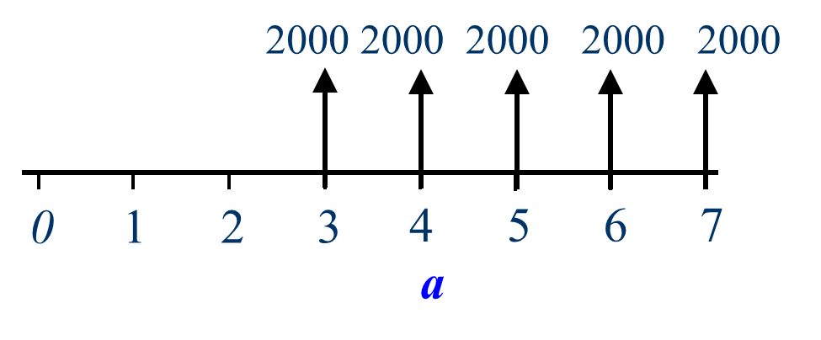
Equivalence Example 1 (cont.)
Let’s move each cash flow set to year 2
Cash flow set a
Cash flow set b
Therefore, are equivalent cash flow sets under
d = 7%

Slide 19
Present and Future Value Example
Consider the cash flows
$ 400
$ 300
$ 200
$ 200
3
0
1
2
4
5
6
7
8
$ 300
d = 6%

Slide 20
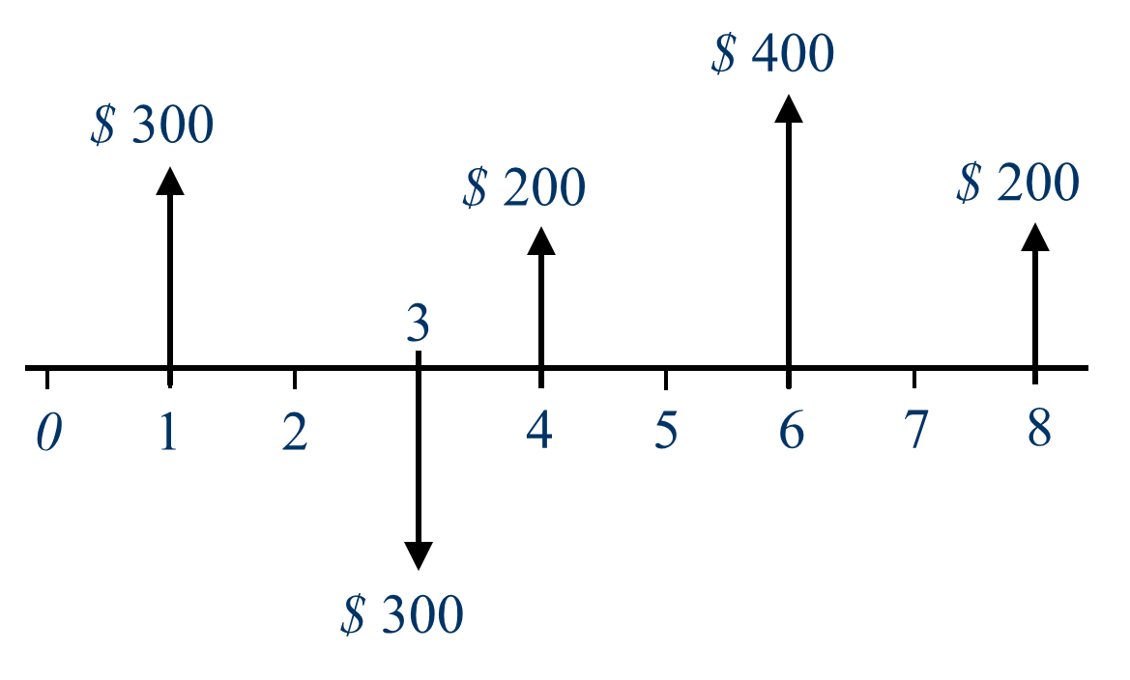
Present and Future Value Example (cont.)
Compute F ₈ at t = 8 for d = 6%
Future Value
Next compute P
Present Value

Slide 21
Present and Future Value Example (cont.)
F _{8 (i.e. t = 8)} = $ 951.56 for d = 6%
Future Value
P_{(i.e. t = 0)} = $ 597.04 for d = 6%
Present Value
Check equivalency
✓

Slide 22
Annualized Investment
A capital investment (i.e. renewable energy project) requires funding
Borrowed from a bank
Obtained from investors, or
Supplied from the owner’s own accounts
Conceptually, an investment is a loan w/ i that converts investment costs into a series of equal annual payments that return capital to the investor

Slide 23
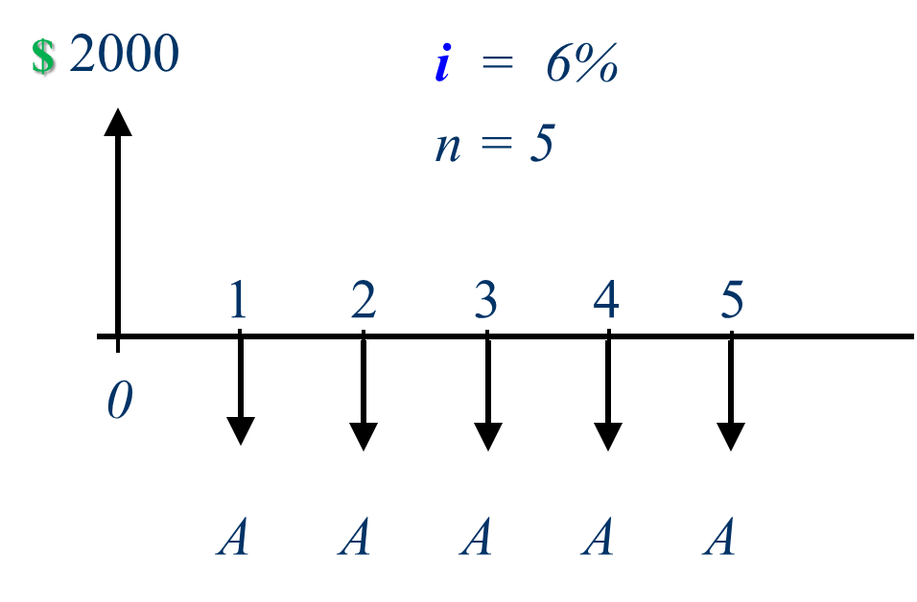
Annual Payments Example
What value must A have to make these cash flows equivalent?
Solution: Find A such that the NPV = 0
Write down the equation for the net present value of the cash flow set, set equal to zero, then solve for A

Slide 24
Cash Flows (cont.)
Carrying forward: NPV of the cash flow set, set equal to zero, solves for A
Annualized Value (A)
As d goes to zero?

Slide 25
Annualized Investment
Then, the equal annual payments are given by
The CRF (i, n) = $\frac{1}{PVF}$
CRF is a measure of the speed at which the initial investment is repaid
Microsoft Excel’s CRF: PMT(rate, nper, pv)
Capital Recovery Factor (CRF)

Slide 26
Mortgage payment example
What is the monthly payment for a $100K, 15 year mortgage w/ i = 0.5% monthly?
= PMT (0.005, 180, 100,000)
= $ 843.86 / month
If terms change to 20 year mortgage, payment goes to $ 716 / month
Assume a $100K investment in a PV installation w/ a 15 year life, 0.5% monthly interest rate, and $ No O&M expenses.
What is monthly income needed to cover the loan?
Solution is the same as above

Slide 27
Equivalence – Common Conversion Factors
Common conversion factors
Present Value function (PVF): (P|A, d %, n) and (P|F, d %, n)
Future Value function (FVF): (F|A, i %, n) and (F|P, i %, n)
Capital Recovery Factor (CRF): (A|P, i %, n)
PVF $\left(year\right)$
CRF $\left(\frac{1}{year}\right)$
P = Present value
F = Future value
A = Annual value

Slide 28
Infinite Horizon Cash-Flow Sets
Consider a uniform cash-flow set
For an infinite horizon uniform cash-flow set
d = “ simple rate of return”
$\frac{1}{d}$ = “simple payback”
d is also the CRF, since A = d P

Slide 29
Internal Rate of Return
Thus far, we have always specified i or d
Next, we’ll “solve for” the rate at which it makes sense to do the project
This is called the internal rate of return, also called the “break-even interest rate”
Higher is better because a higher IRR means that even if the interest rate gets higher, the project still makes sense to do
Note there is no closed form solution - use a table (or Excel, etc.) to look it up

Slide 30
Internal Rate of Return
Consider a cash-flow set
The value of d for which
is called the internal rate of return (IRR)
The IRR is a measure of how fast we recover an investment or stated differently, the speed with which the returns recover an investment

Slide 31
Internal Rate of Return Example
Consider the following cash-flow set
$6,000
$6,000
$6,000
$6,000
$6,000
0
1
2
3
4
8
$30,000

Slide 32
Internal Rate of Return
The present value
has the (non-obvious) solution d ≈ 12%.
From Table A.1: rows = n, values = (P|A, i %, n), cols = IRR
Interpretation: w/ d = 12%, the cash flow PV for the set = 0 and → so 12% is the IRR for the given cash- flow set
The investment makes sense as long as other investments yield less than 12%.
units are years

Slide 33
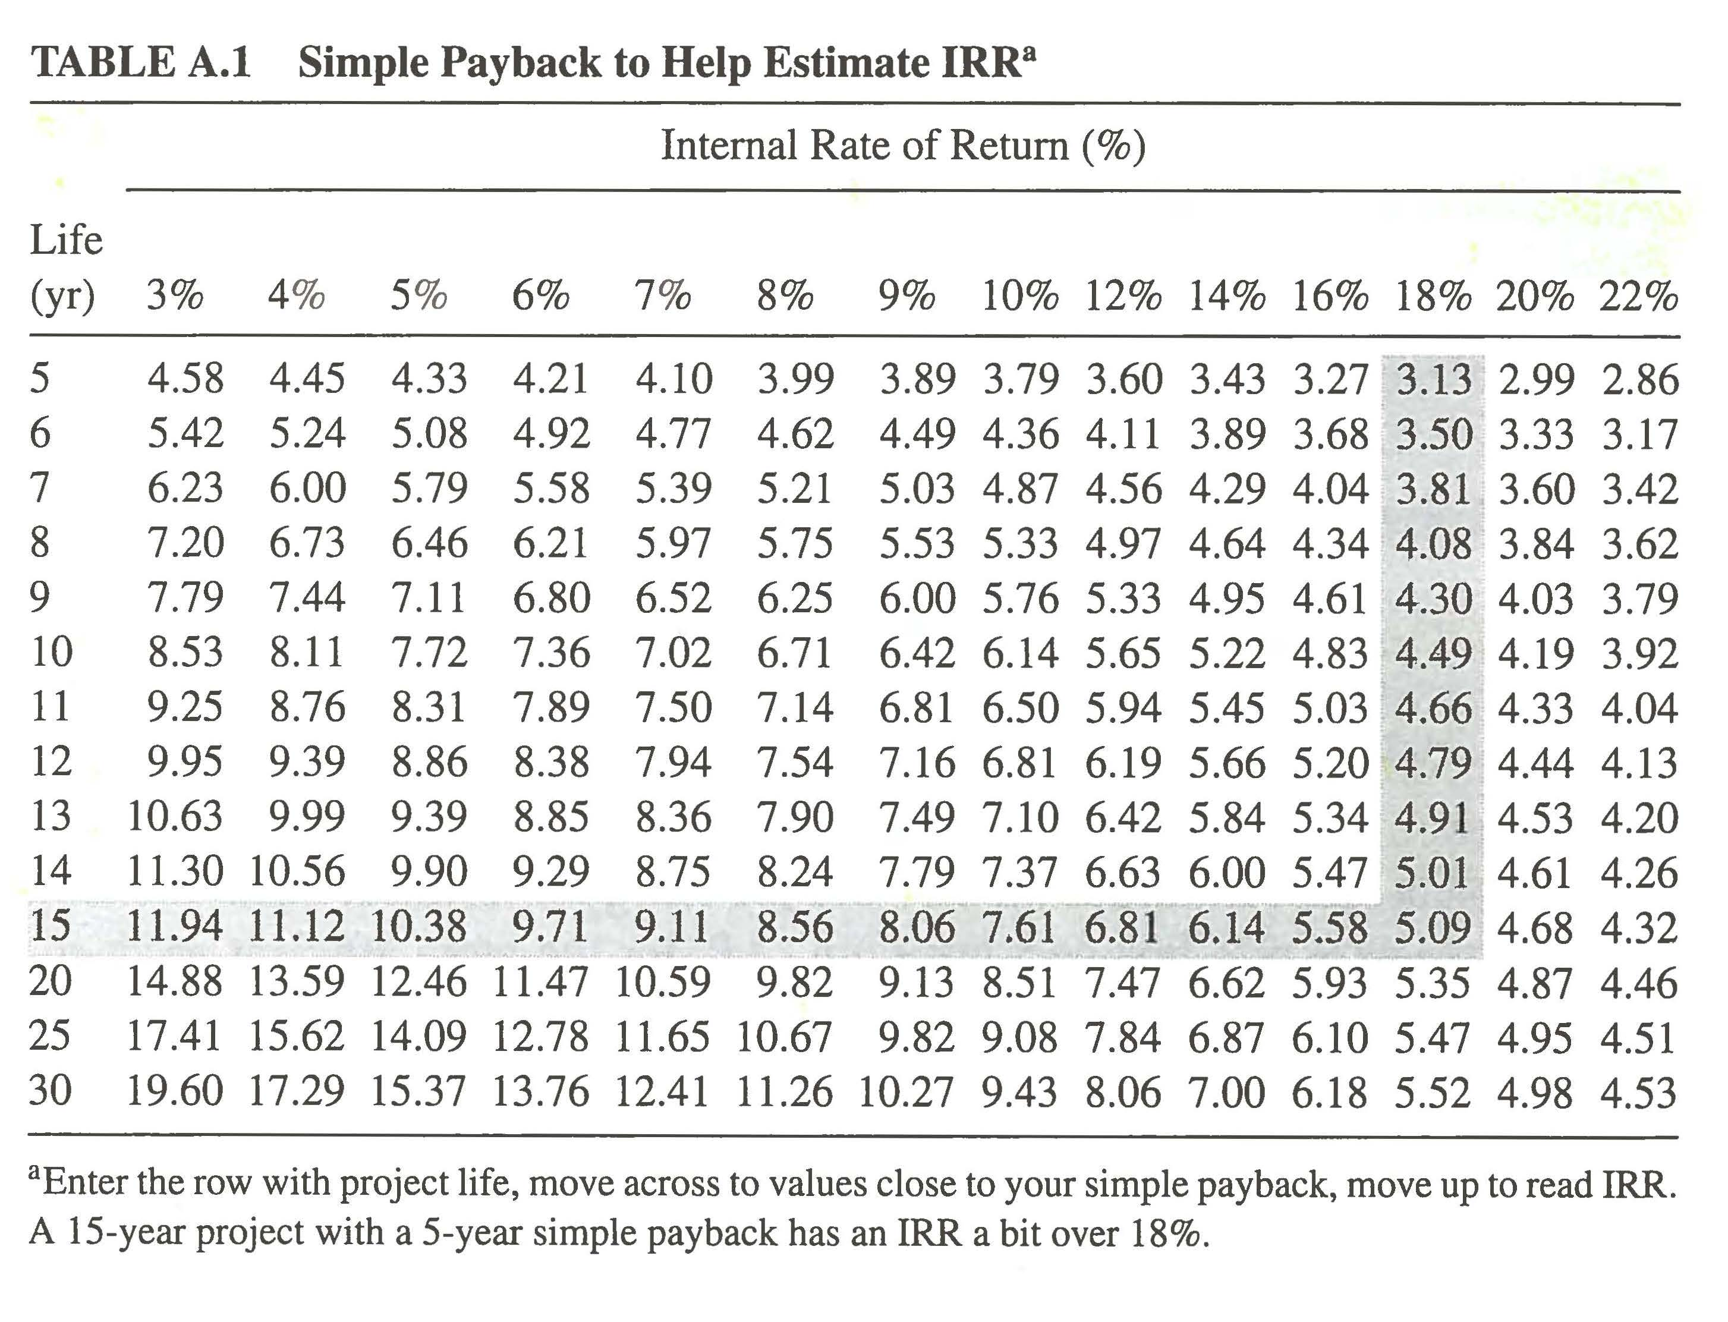
Internal Rate of Return
Present Value
has the (non-obvious) solution d ≈ 12%.
From Table A.1: rows = n, values = (P|A, i %, n), cols = IRR
Interpretation: w/ d = 12%, the cash flow PV for the set = 0 and → so 12% is the IRR for the given cash- flow set
(years)

Slide 34
To Buy or NOT to Buy the Efficient Refrigerator ??
A more efficient refrigerator adds $1,000, but saves Energy = $200 annually. Which refrigerator is better use of $?
For a 10 yr. assumed life, IRR is determined from the solution of
Interpolating

Slide 35
Efficient Refrigerator Example (cont.)
If instead, the refrigerator has a 15 year expected life, IRR becomes

Slide 36
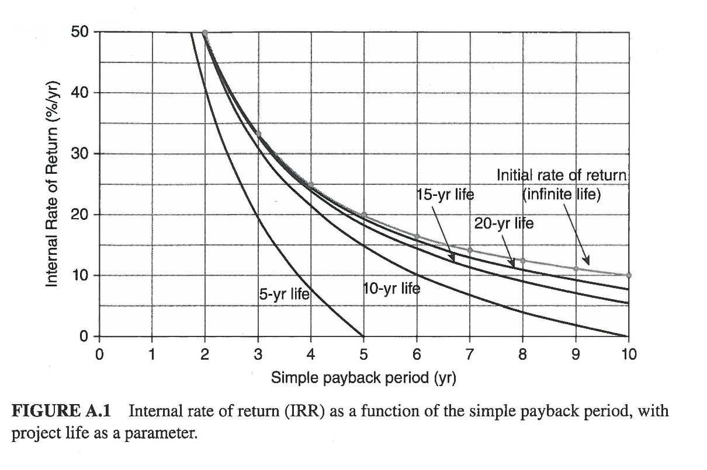
Efficient Refrigerator Example (cont.)
If instead the refrigerator is never fails, the IRR becomes
20
15
10

Slide 37
Impacts of Inflation
Inflation is a general price level increase in an economy;
Equivalently, inflation is a general decline in money’s purchasing power
Inflation is measured using prices; different products may have distinct escalation rates
Typically indices such as the CPI – the consumer price index – use a market basket of goods and services as a proxy for the entire U.S. economy
reference basis is the year 1967 with the price of $ 100 for the basket (L ₀); in the year 1990, the same basket cost $ 374 (L ₂₃)

Slide 38
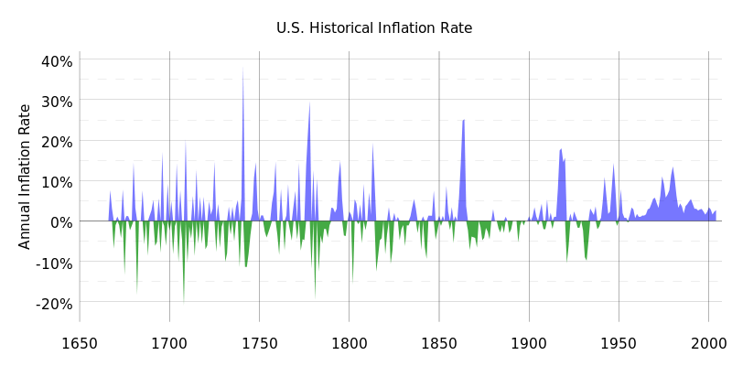
US Inflation Over Last 350 Years
Historically prices have gone up and gone down. Recently many homeowners found home prices can also fall!
Source: http://upload.wikimedia.org/wikipedia/commons/2/20/US_Historical_Inflation_Ancient.svg

Slide 39
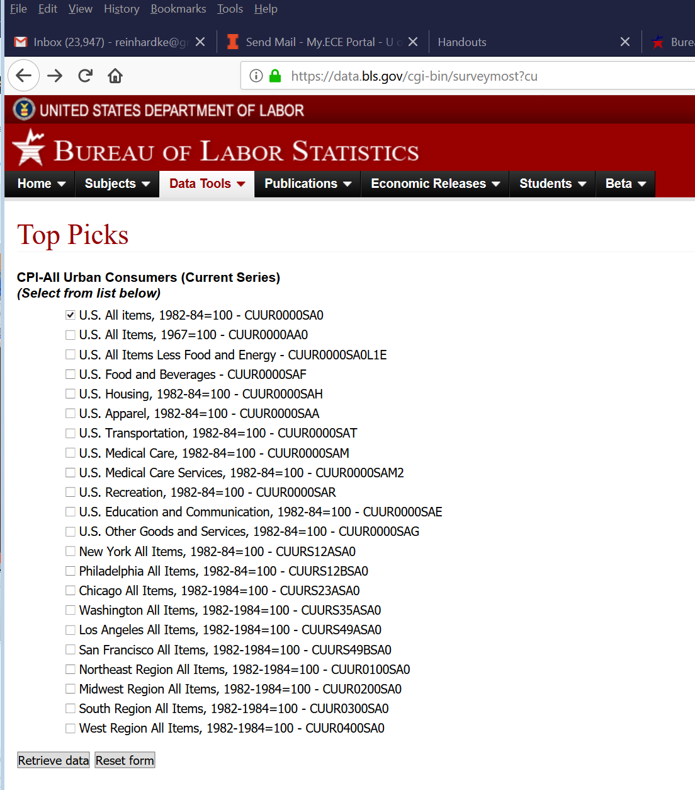
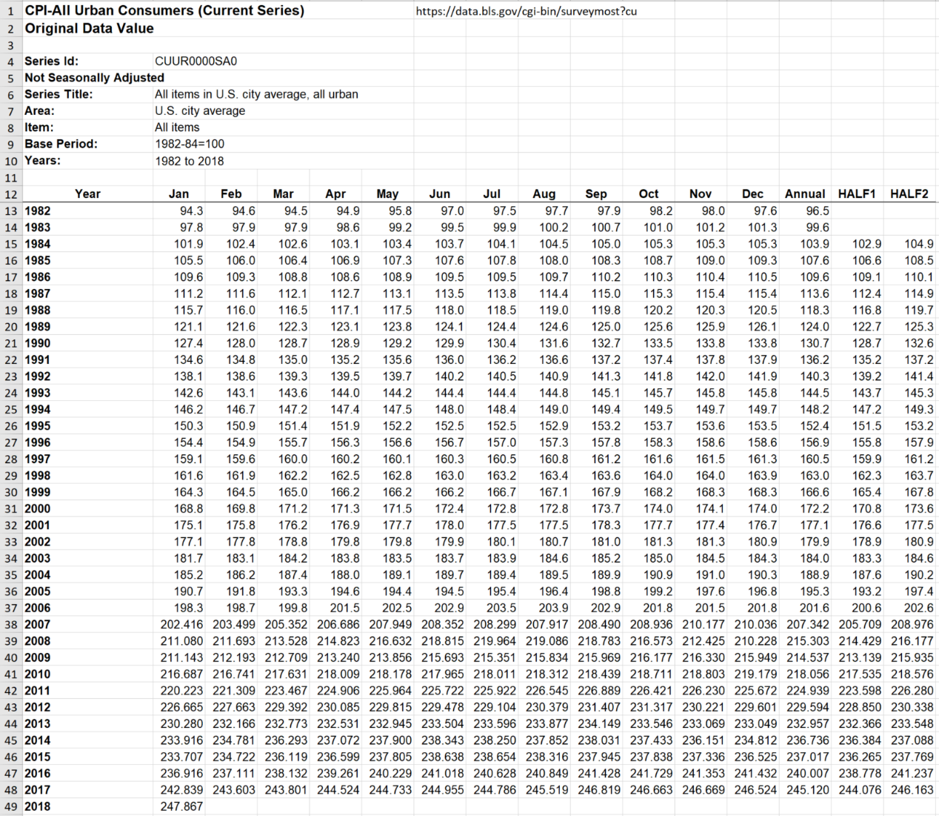
Computing U.S. Average Inflation Rate (e)
Calculate average inflation rate from 1982 to 2014
https://data.bls.gov/cgi-bin/surveymost?cu
CPI Methodology Bureau of Labor Statistics https://www.bls.gov/cpi/questions-and-answers.htm

Slide 40
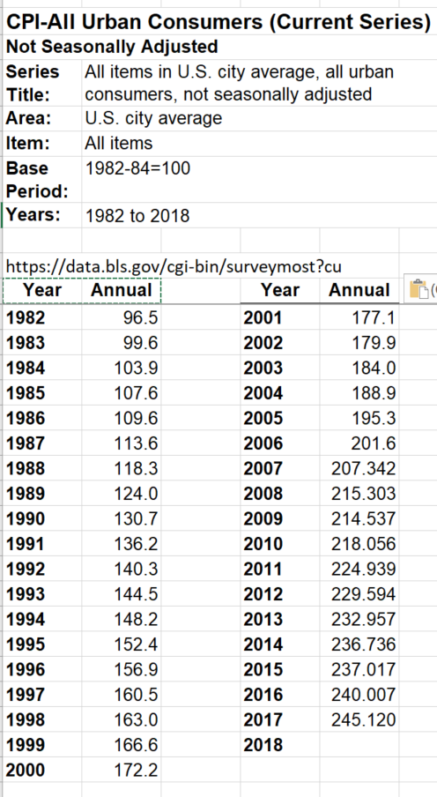
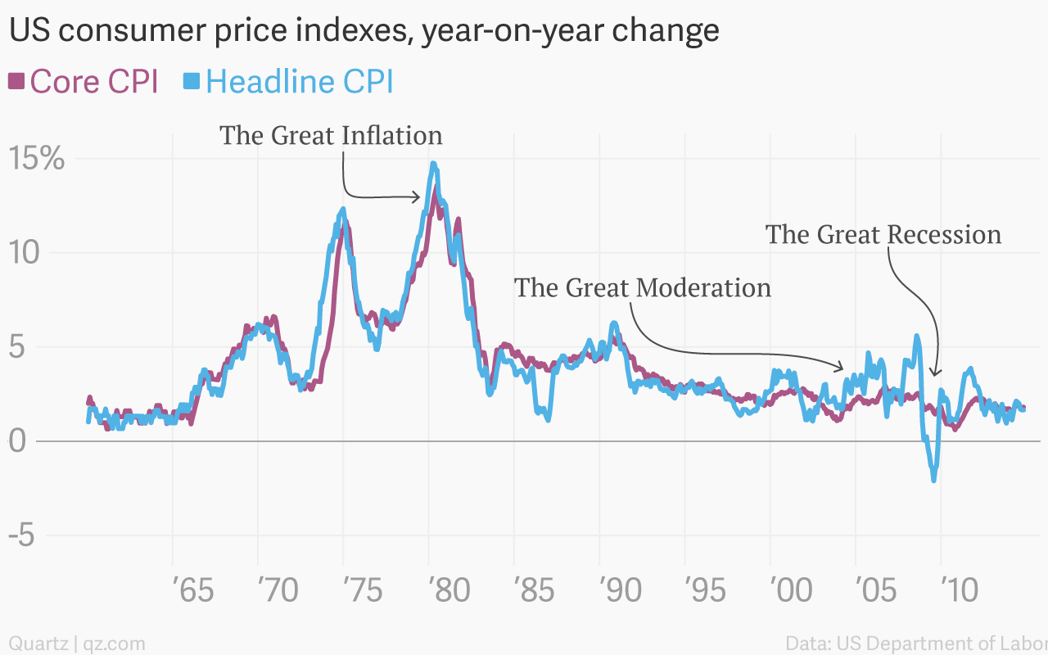
Computing U.S. Average Inflation Rate (e)
Calculate average inflation rate from 1982 to 2014
CPI Methodology Bureau of Labor Statistics https://www.bls.gov/cpi/questions-and-answers.htm
https://qz.com/299915/the-greatest-chart-ever-made-about-us-cpi-inflation/

Slide 41
Inflation (Escalation) Rate
W/ escalation, $1 | _{year 0} becomes $(1+ e )| _{year 1}, etc., so
Comparing terms to find an equivalent discount rate $d ′$:
Can be used in all PVF relations developed

Slide 42
VIDEO TIME!
http://www.investopedia.com/terms/t/timevalueofmoney.asp
41

Slide 43
VIDEO TIME!
http://www.investopedia.com/terms/c/cashflow.asp

Slide 44
VIDEO TIME!
http://www.investopedia.com/terms/d/discountrate.asp
43

Slide 45
Internal Rate of Return
http://www.investopedia.com/terms/i/irr.asp
44
44

Slide 46
Inflation
http://www.investopedia.com/terms/i/inflation.asp
45
45

